Slide 1
Dispersion Tailoring in a Silicon Strip Waveguide With Alumina Thin-Film Coating For Nonlinear Wavelength Conversion 陈稼霖
2020 Fall Semester
2020/12/22

Slide 2
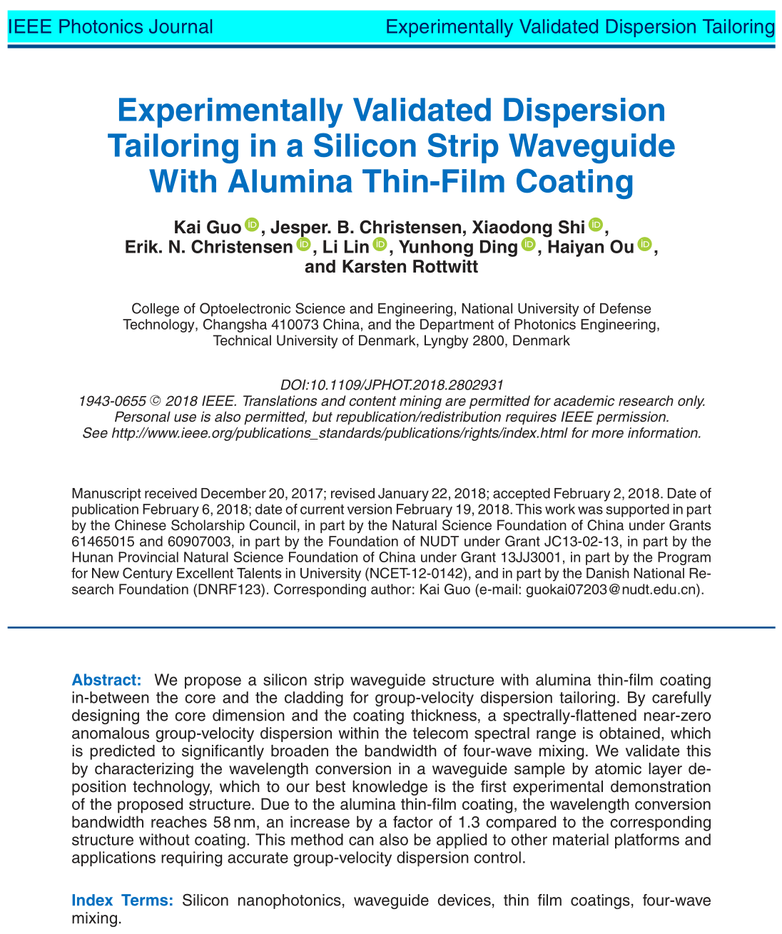
Content
Background of FWM
Optimization Goals
Simulation Process & Results
Experiment Validation

Slide 3
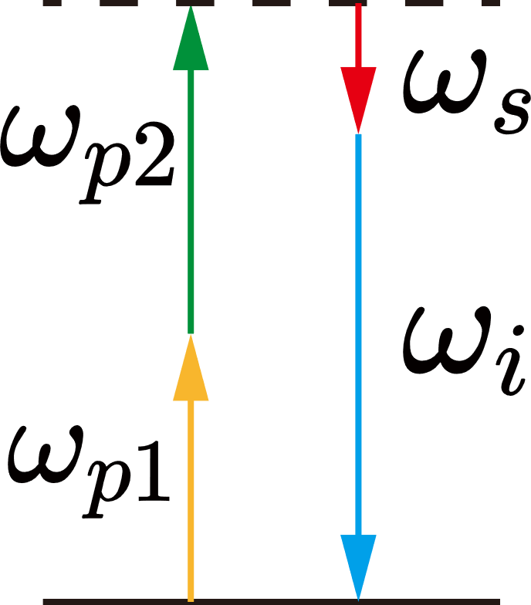
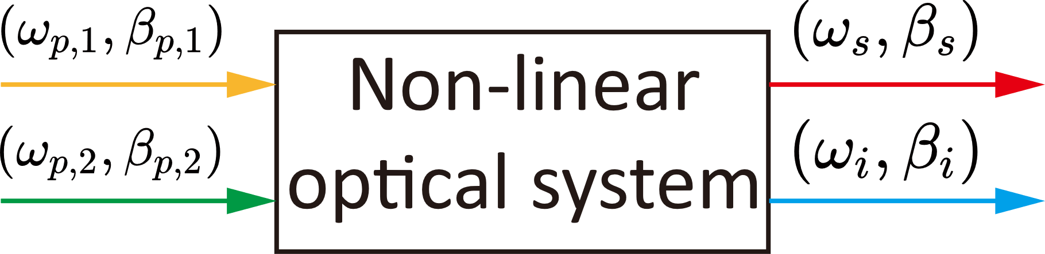
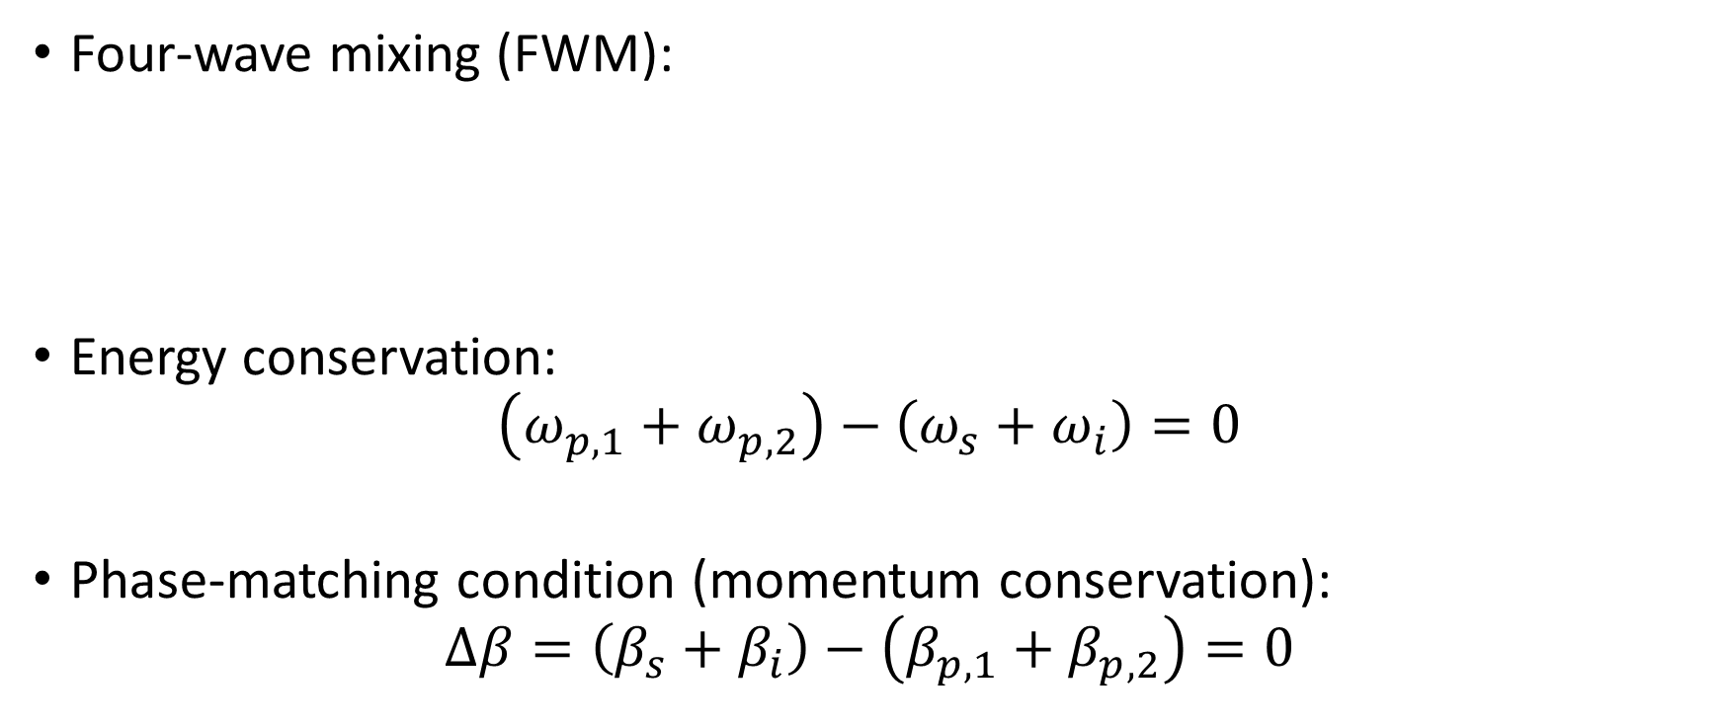
Background of FWM
Four-wave mixing (FWM):
Energy conservation:
$$\left(ω_{p,1}+ω_{p, 2}\right)−\left(ω_{s}+ω_{i}\right)=0$$
Phase-matching condition (momentum conservation):
$$Δβ=\left(β_{s}+β_{i}\right)−\left(β_{p,1}+β_{p,2}\right)=0$$
signal
pump
idle

Slide 4
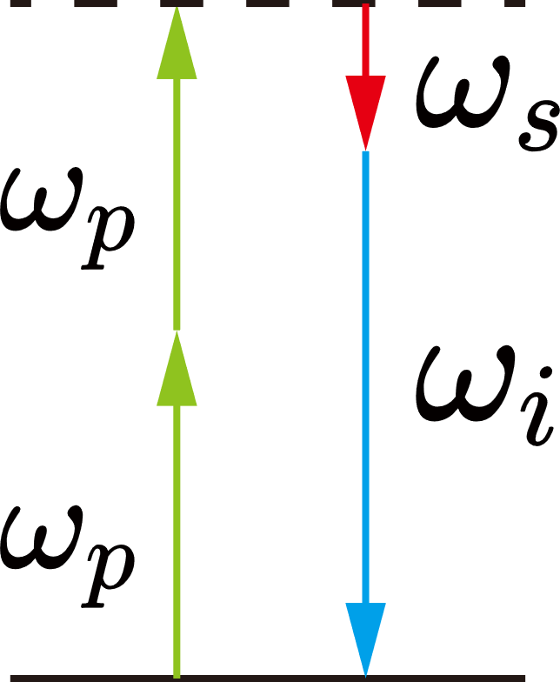
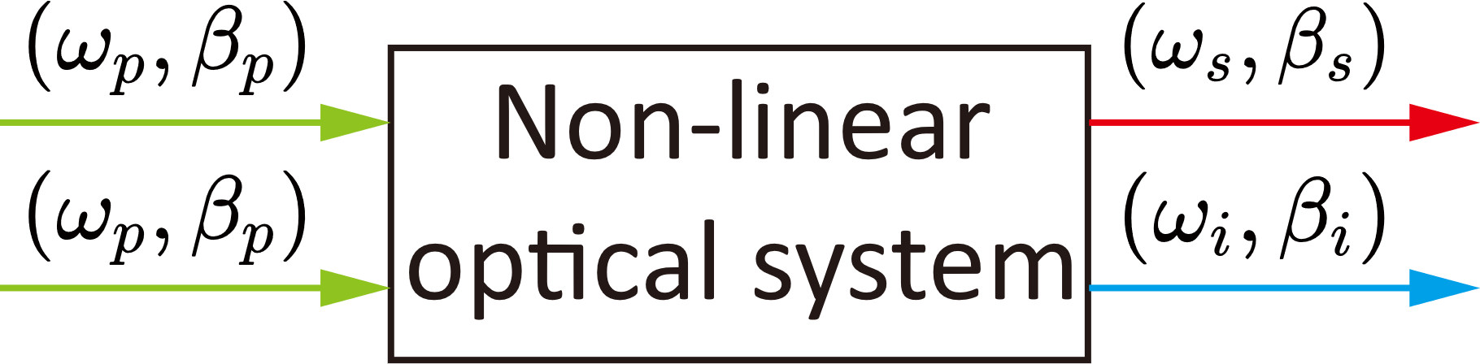
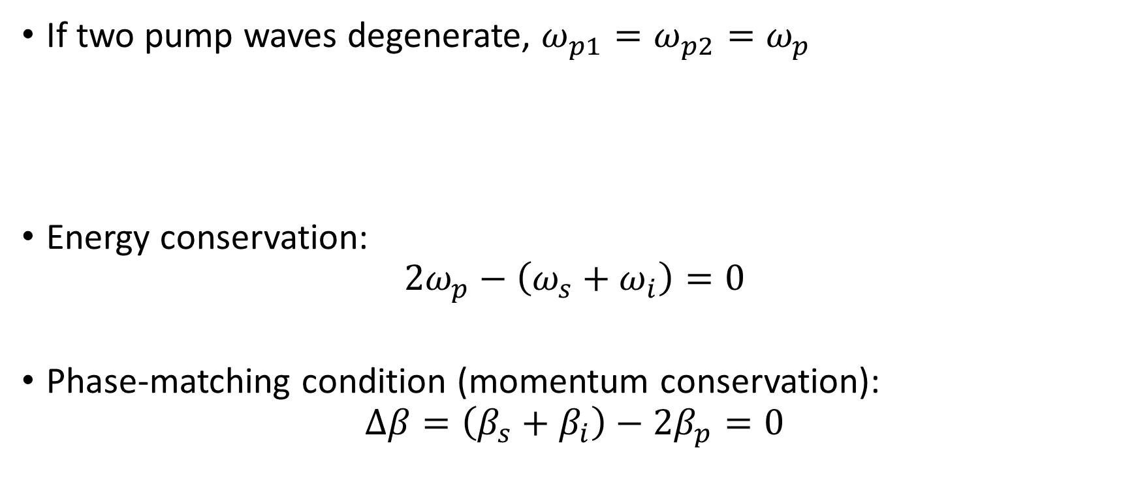
Background of FWM
If two pump waves degenerate, $ω_{p1}=ω_{p2}=ω_{p}$
Energy conservation:
$$2ω_{p}−\left(ω_{s}+ω_{i}\right)=0$$
Phase-matching condition (momentum conservation):
$$Δβ=\left(β_{s}+β_{i}\right)−2β_{p}=0$$
signal
pump
idle

Slide 5
Background of FWM
Application of FWM:
Frequency Division Multiplexing
Weak pulse coherent photon-pair generation

Slide 6
Optimization Goal 1
Anomalous dispersion
Flattened and broadband conversion efficiency main lobe
Conversion efficiency of side lobe decrease dramatically

Slide 7
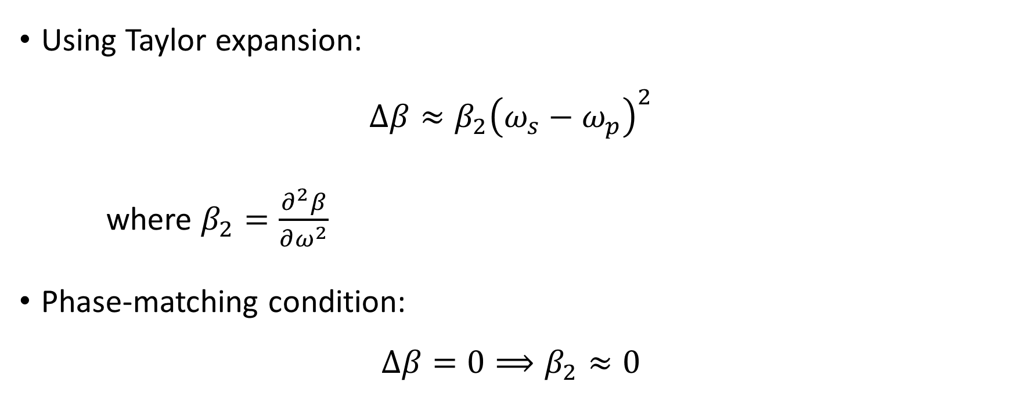
Optimization Goal 2
Using Taylor expansion:
$$Δβ≈β_{2}{\left(ω_{s}−ω_{p}\right)}^{2}$$
where $β_{2}=\frac{∂^{2}β}{∂ω^{2}}$
Phase-matching condition:
$$Δβ=0⟹β_{2}≈0$$

Slide 8
Optimization Goal 3
Small nonlinear coefficient
Wavelength conversion need higher power
Small mode area

Slide 9
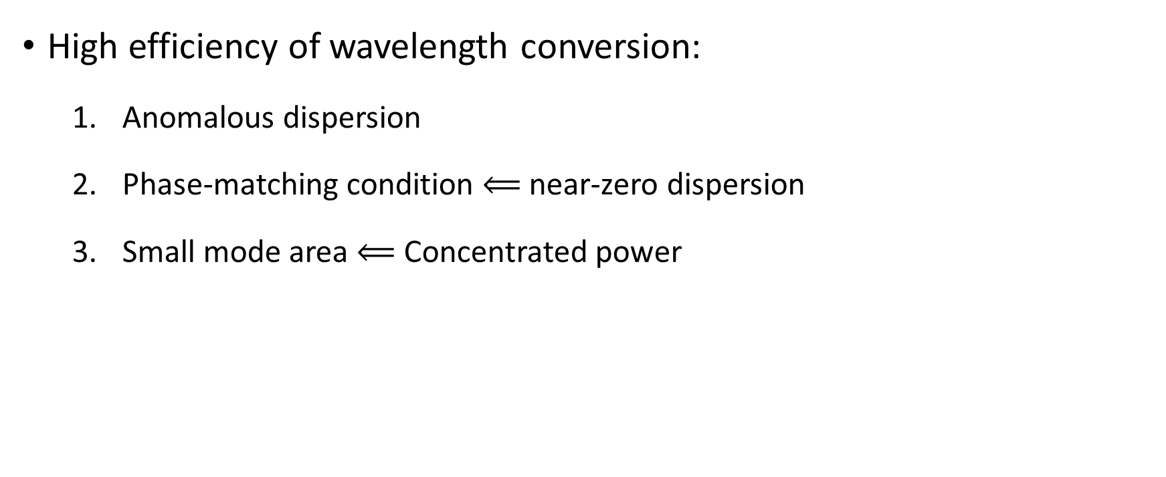
Optimization Goals
High efficiency of wavelength conversion:
Anomalous dispersion
Phase-matching condition $⟸$ near-zero dispersion
Small mode area $⟸$ Concentrated power

Slide 10
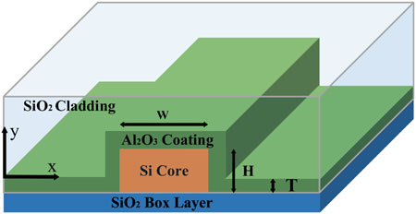
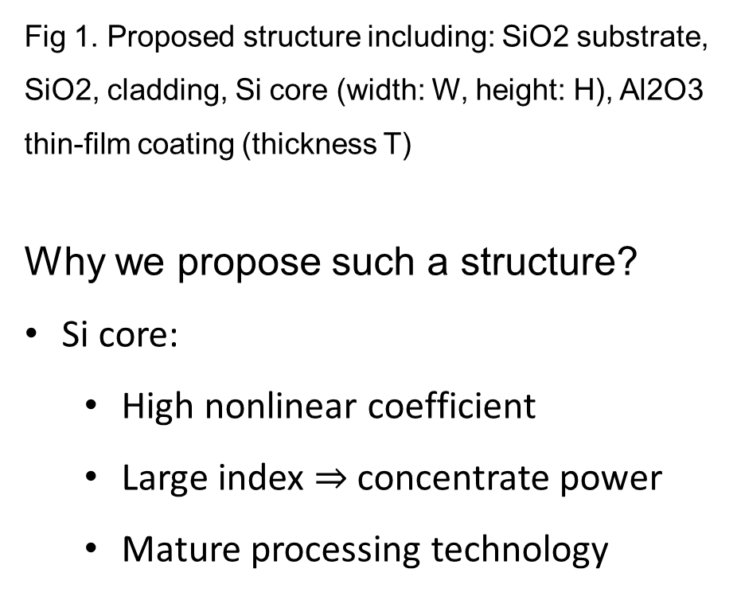
Simulation Process & Results
Fig 1. Proposed structure including: SiO2 substrate, SiO2, cladding, Si core (width: W, height: H), Al2O3 thin-film coating (thickness T)
Why we propose such a structure?
Si core:
High nonlinear coefficient
Large index $⇒$ concentrate power
Mature processing technology

Slide 11
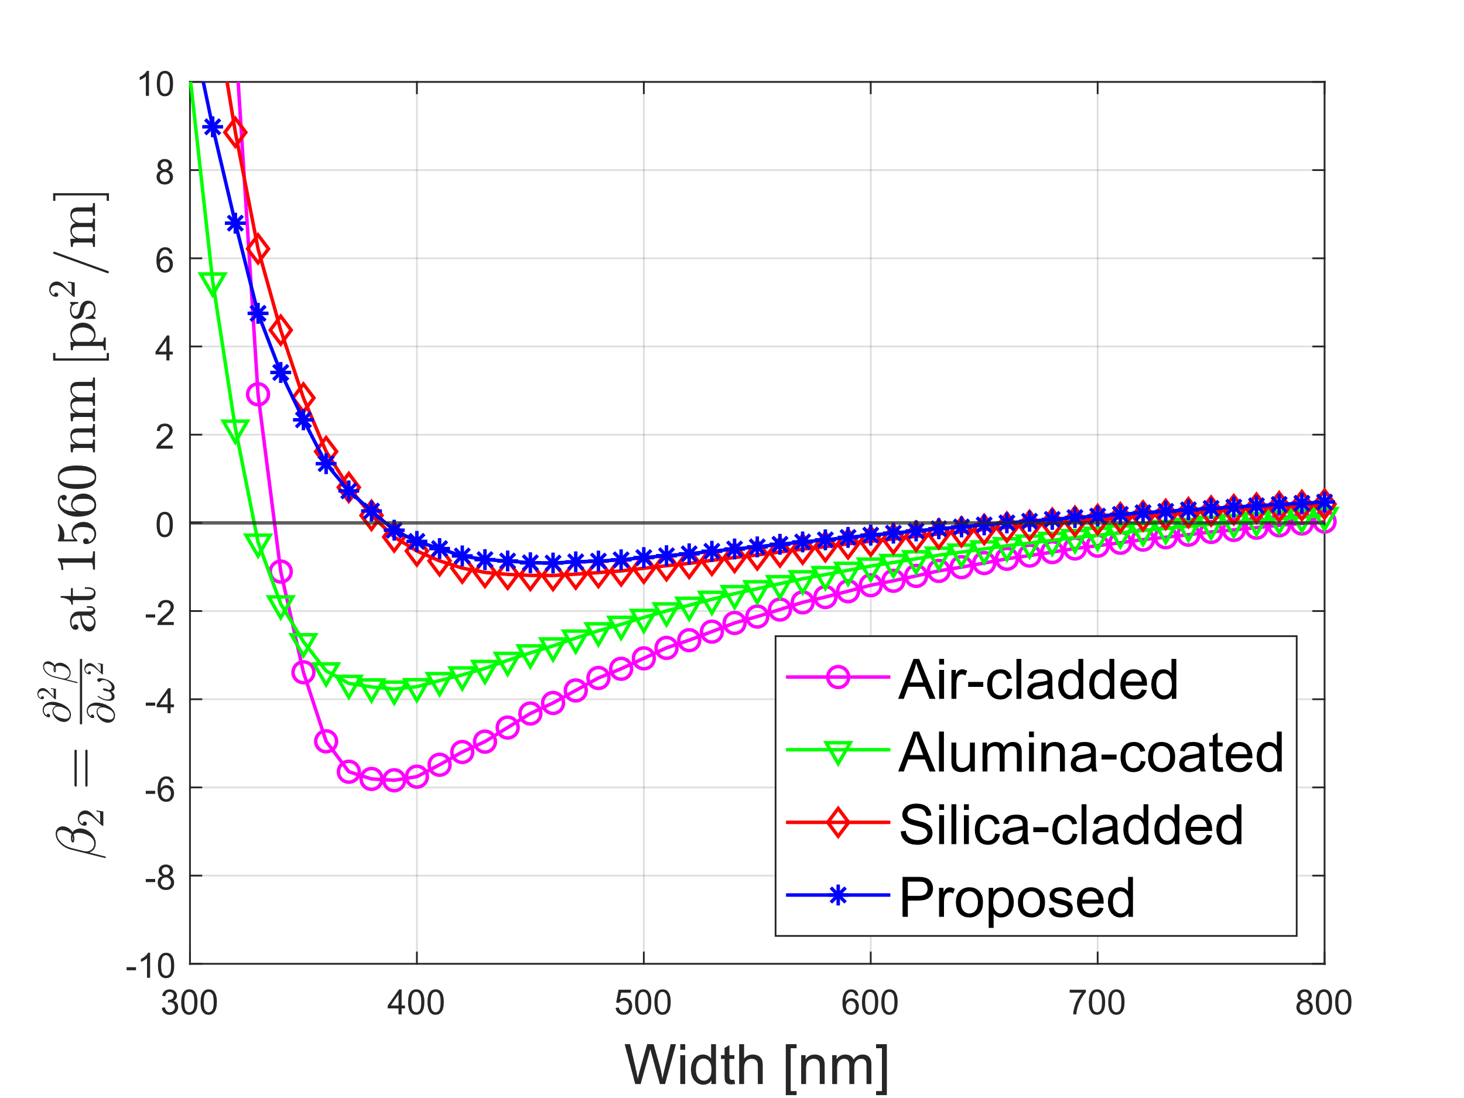
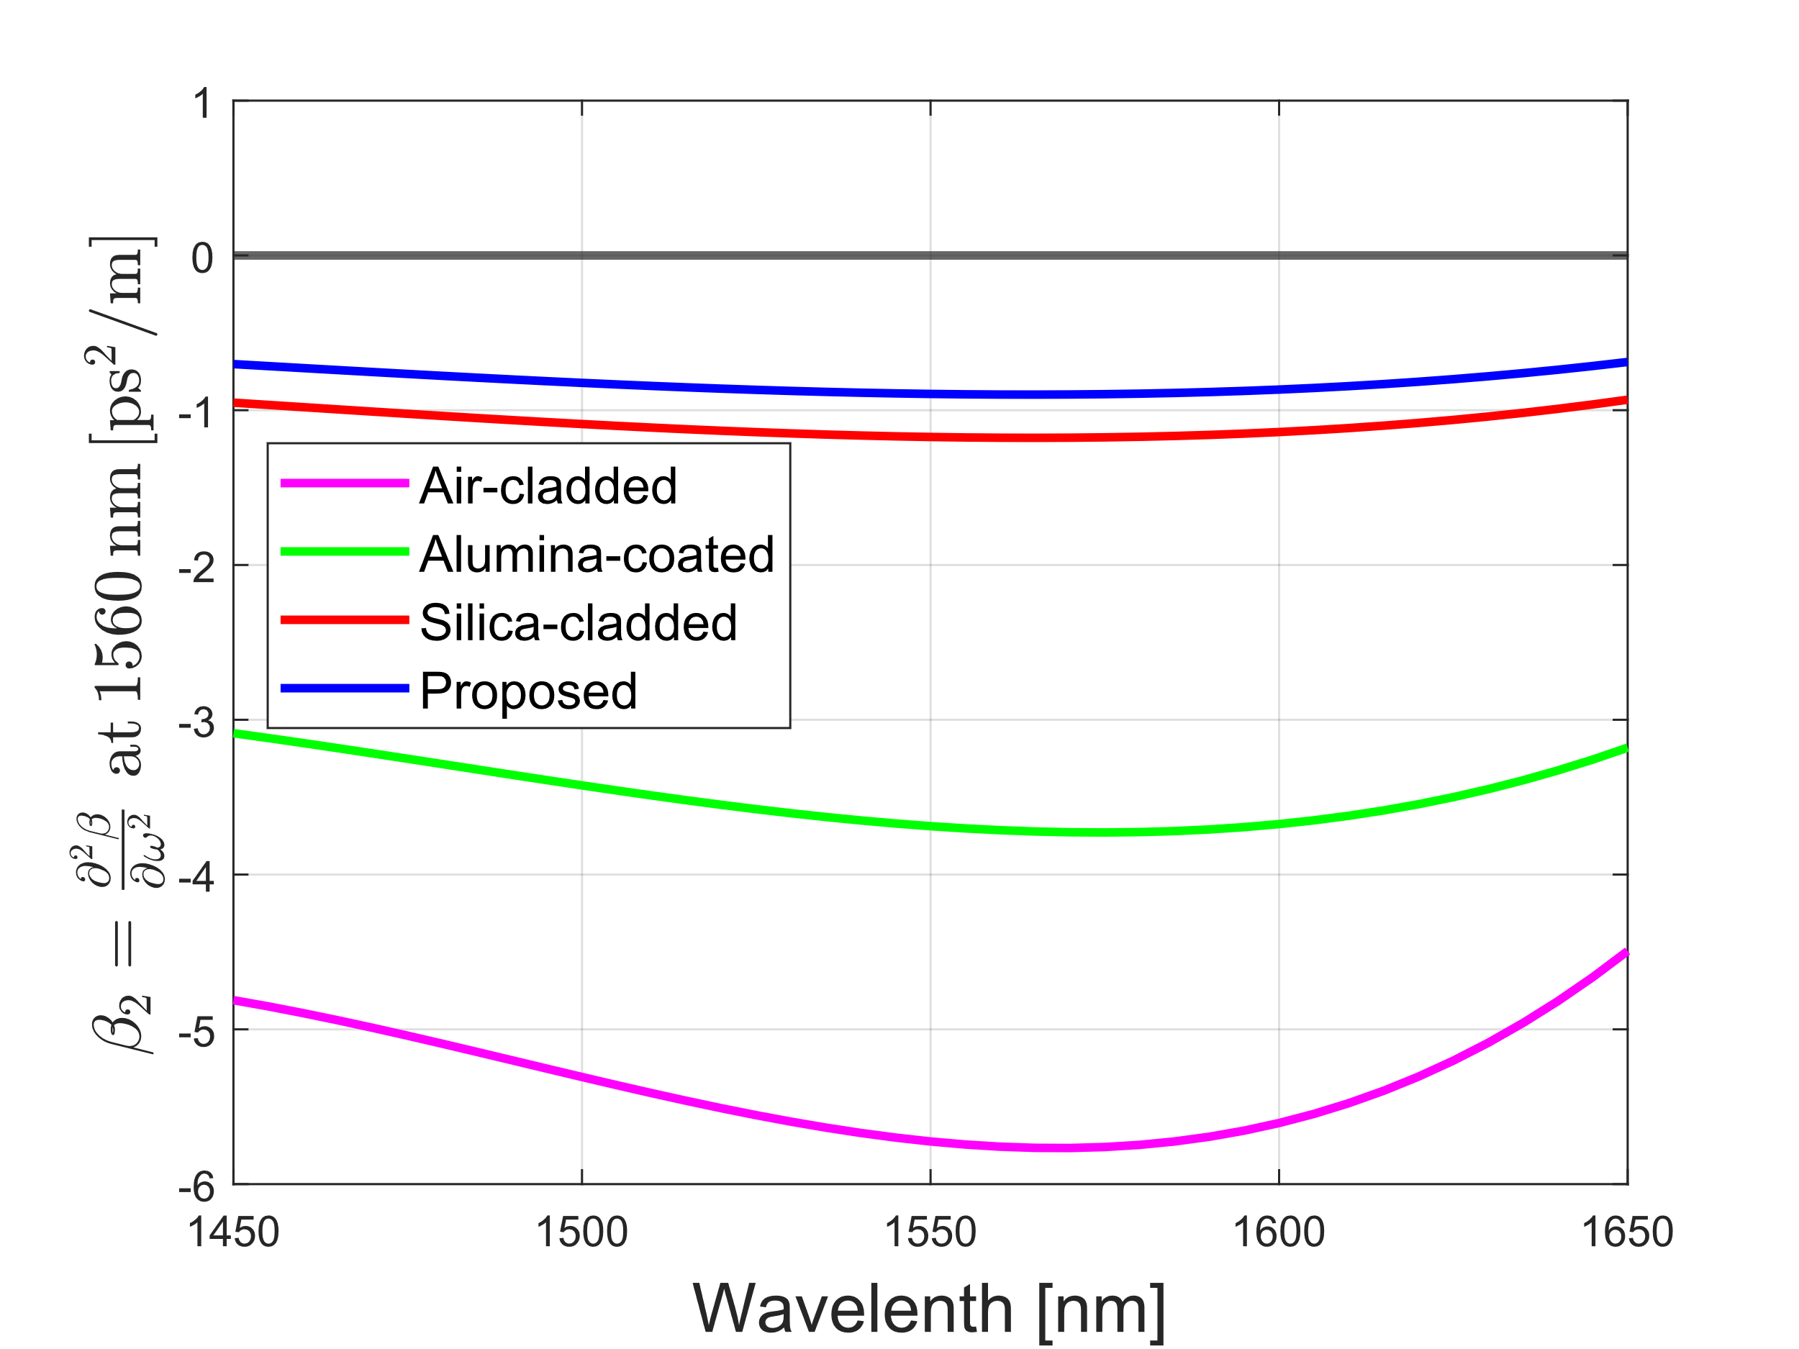
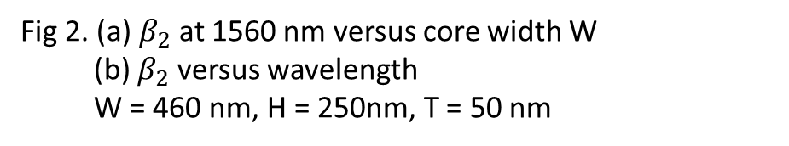
Simulation Process & Results
(a)
Why we propose such a structure?
Al2O3 coating:
Add more degree of freedom for optimization, so that it can reach better performance than other structure
Mature processing tech
(b)
Fig 2. (a) $β_{2}$ at 1560 nm versus core width W
(b) $β_{2}$ versus wavelength
W = 460 nm, H = 250nm, T = 50 nm

Slide 12
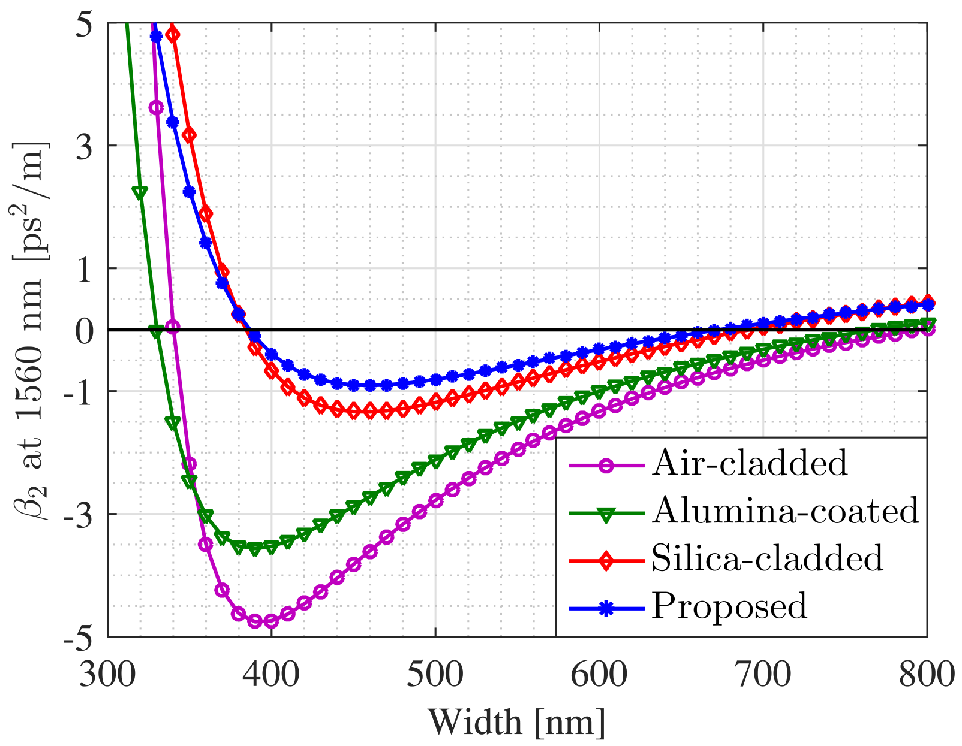
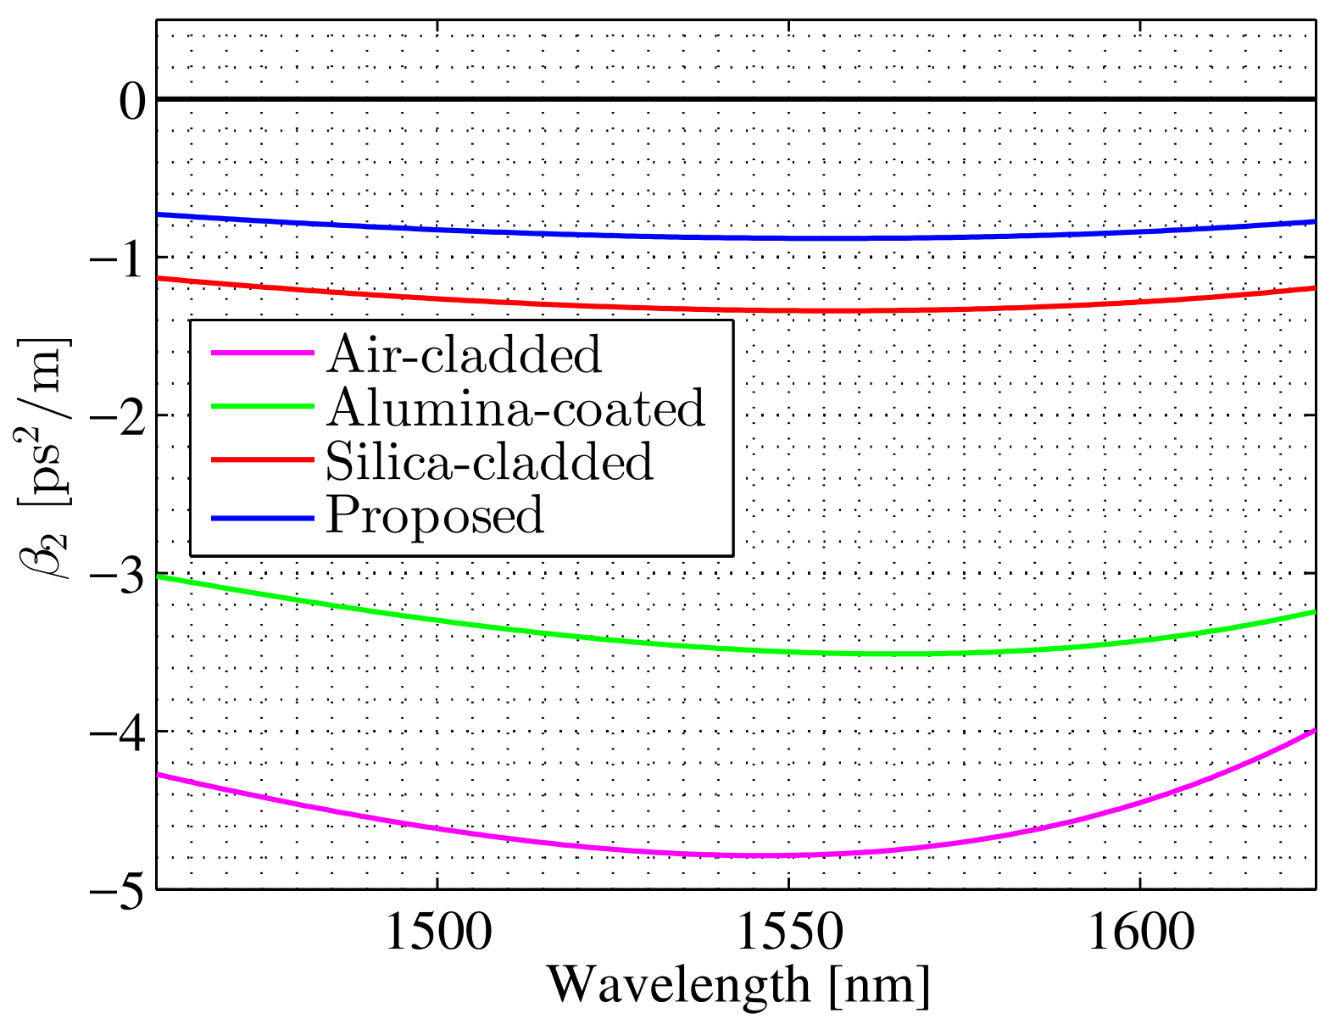
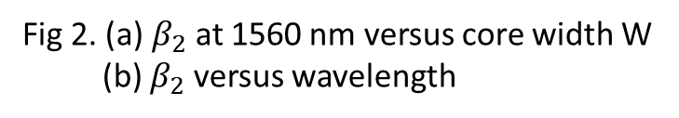
Simulation Process & Results
(a)
Original figures are obtained using method from [2] and data from [3].
(b)
Fig 2. (a) $β_{2}$ at 1560 nm versus core width W
(b) $β_{2}$ versus wavelength
[2] Fallahkhair, Arman B., Kai S. Li, and Thomas E. Murphy. "Vector finite difference modesolver for anisotropic dielectric waveguides." Journal of Lightwave Technology 26.11 (2008): 1423-1431.
[3] Boidin, Rémi, et al. "Pulsed laser deposited alumina thin films." Ceramics International 42.1 (2016): 1177-1182.

Slide 13
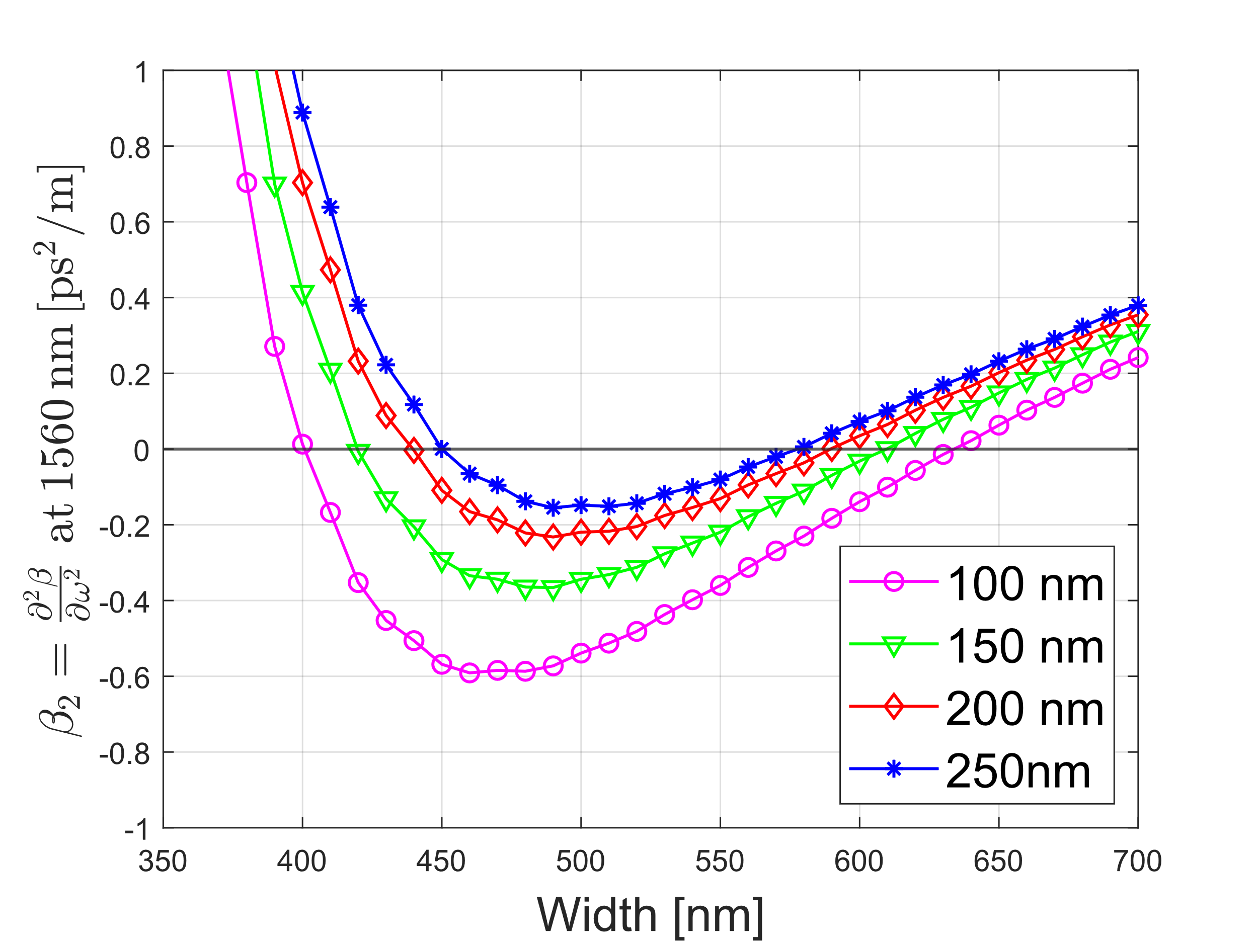
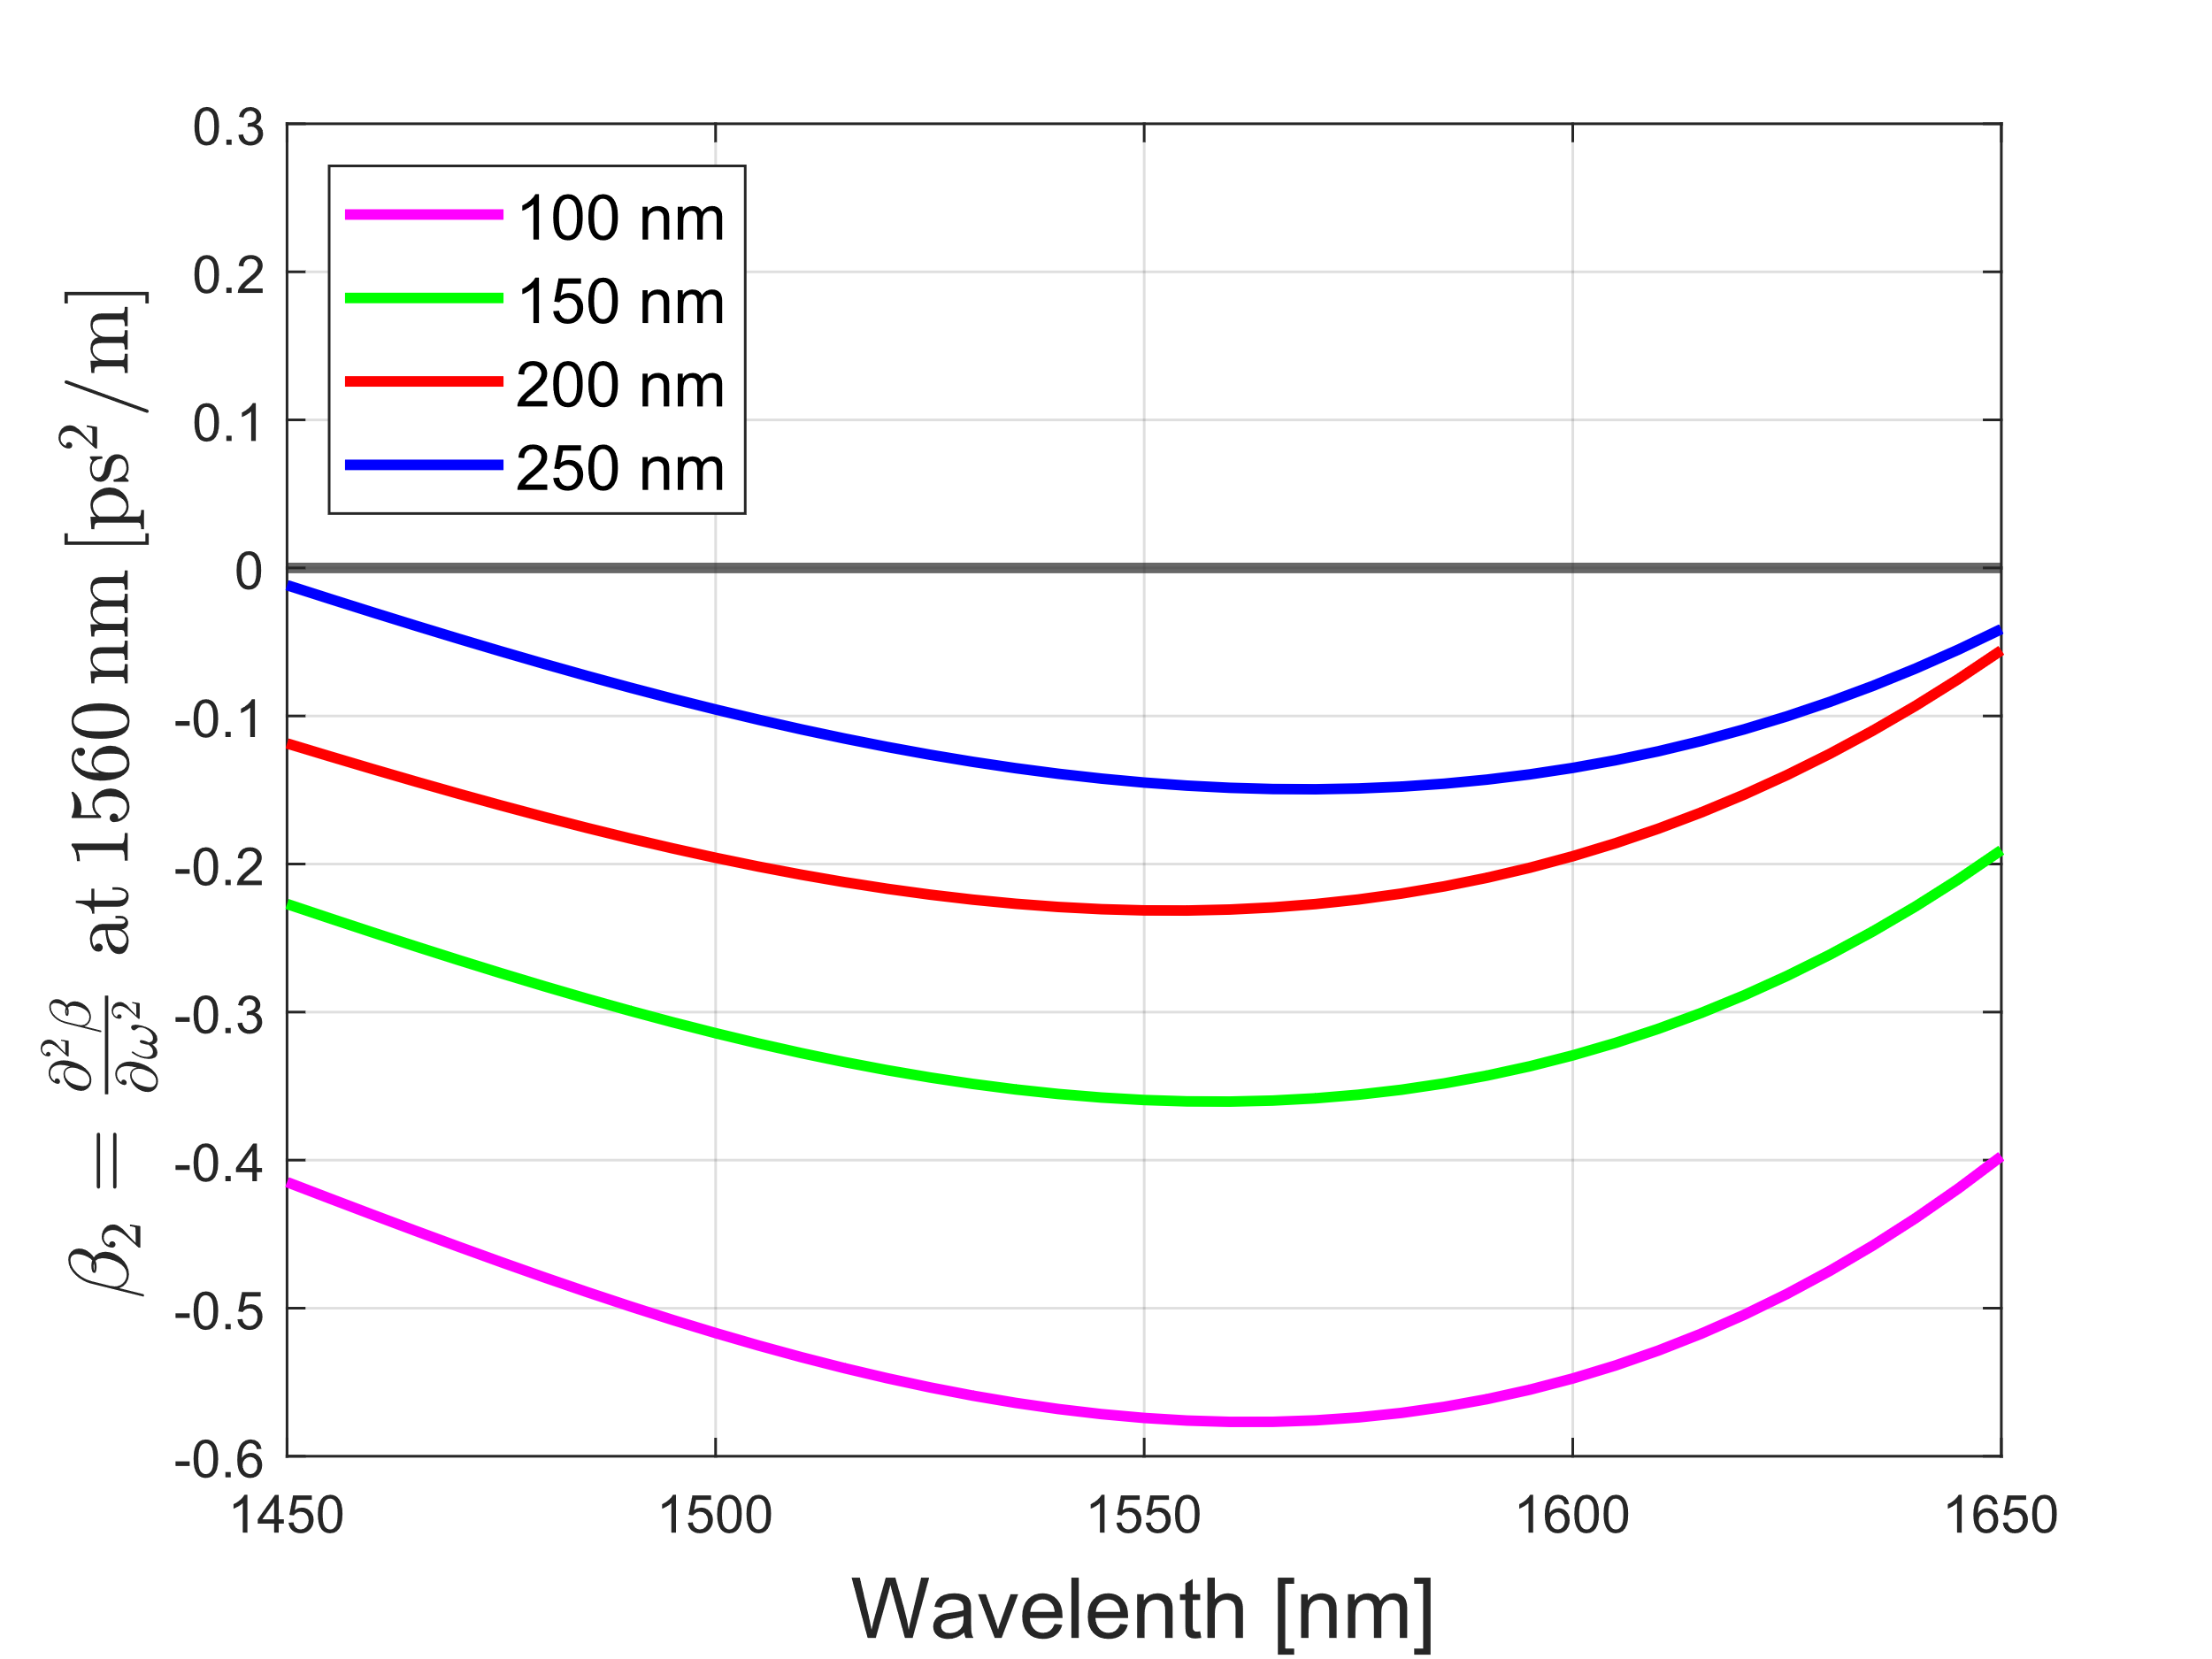
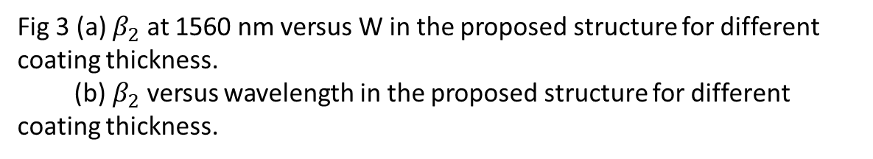
Simulation Process & Results
(a)
Change W to reach anomalous near-zero dispersion.
(b)
Change T to reach anomalous near-zero dispersion.
Fig 3 (a) $β_{2}$ at 1560 nm versus W in the proposed structure for different coating thickness.
(b) $β_{2}$ versus wavelength in the proposed structure for different coating thickness.

Slide 14
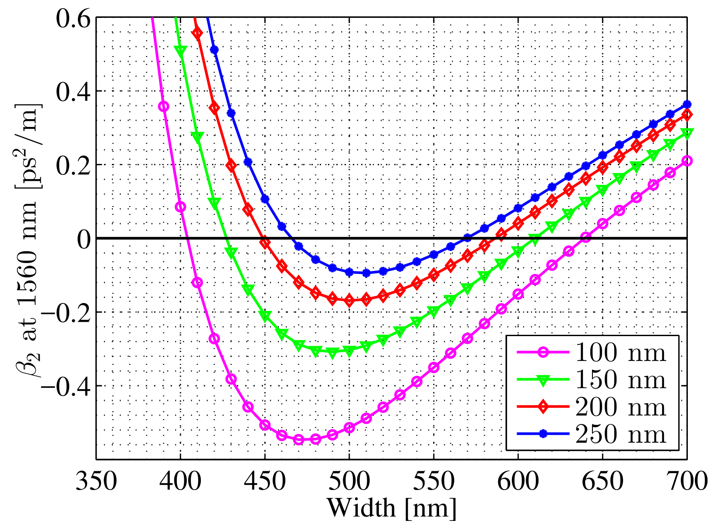
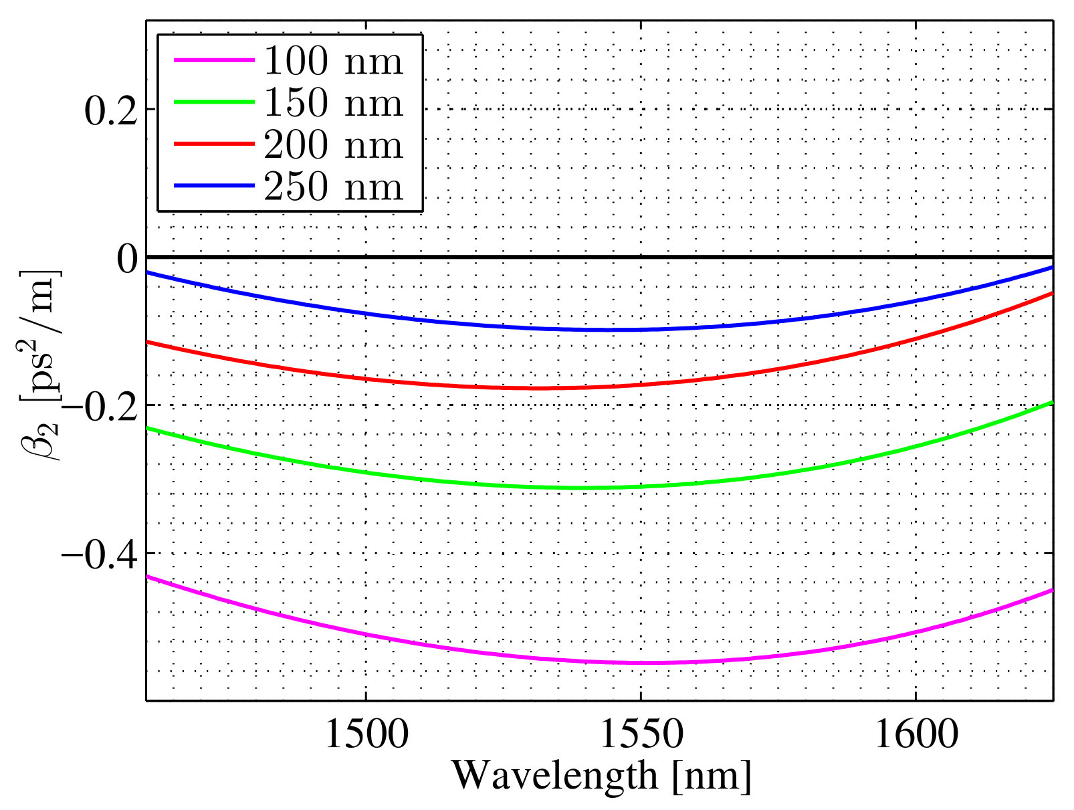
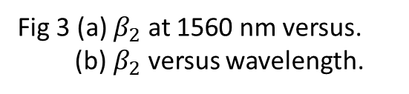
Simulation Process & Results
(a)
Original figures
(b)
Fig 3 (a) $β_{2}$ at 1560 nm versus.
(b) $β_{2}$ versus wavelength.

Slide 15
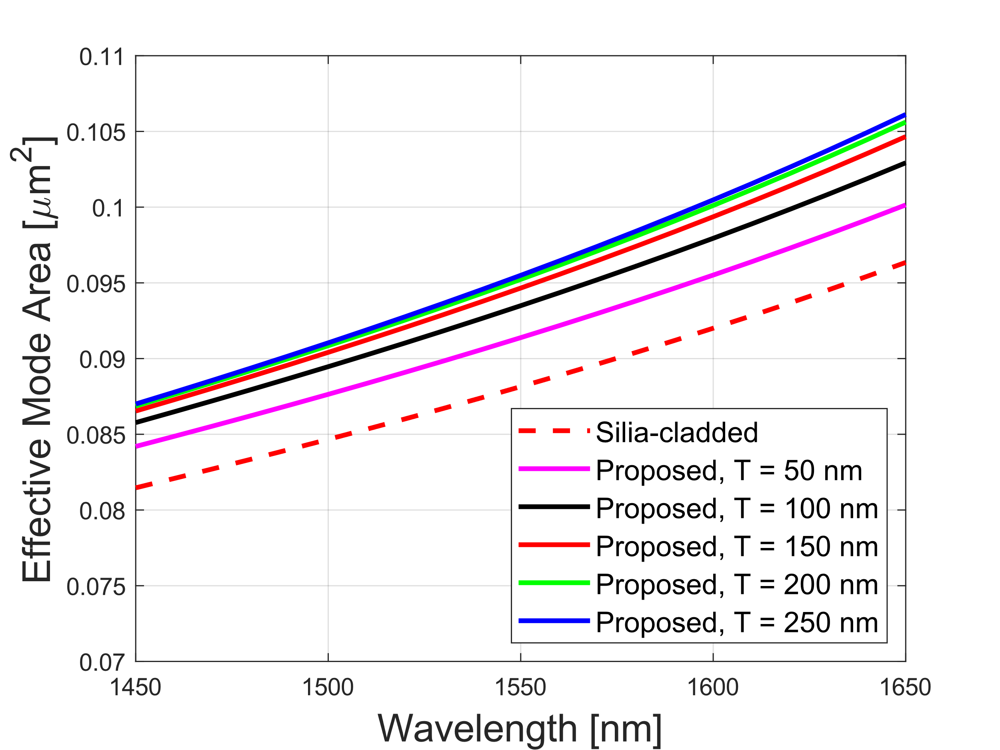
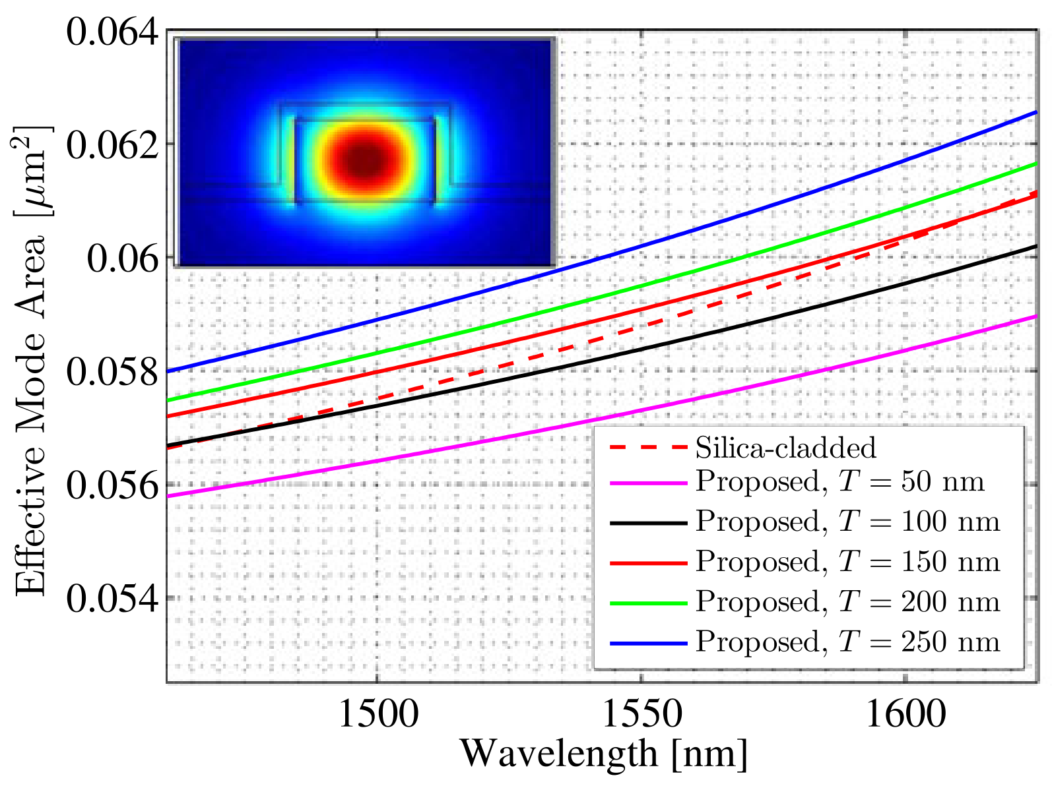
Simulation Process & Results
As for mode area, ……
Original figures
Fig 4. (a) Effective mode area versus wavelength.

Slide 16
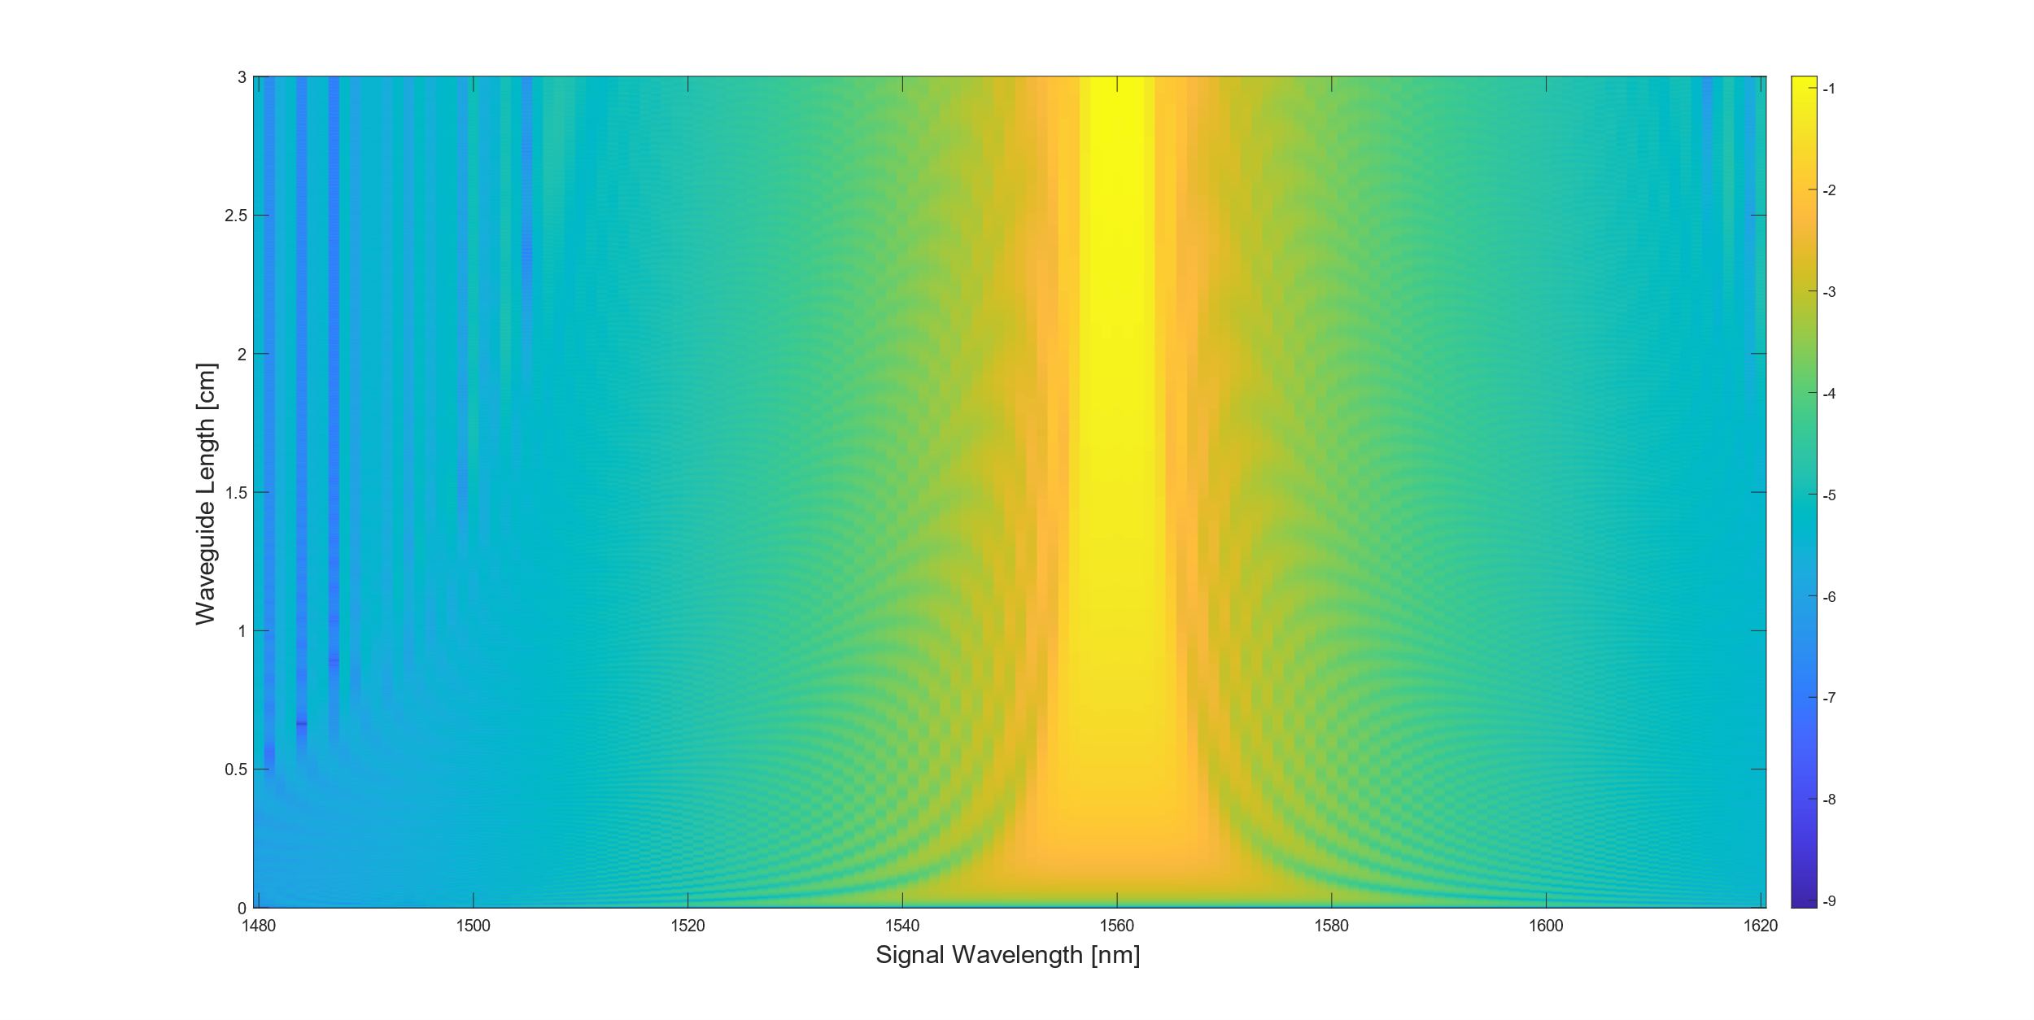
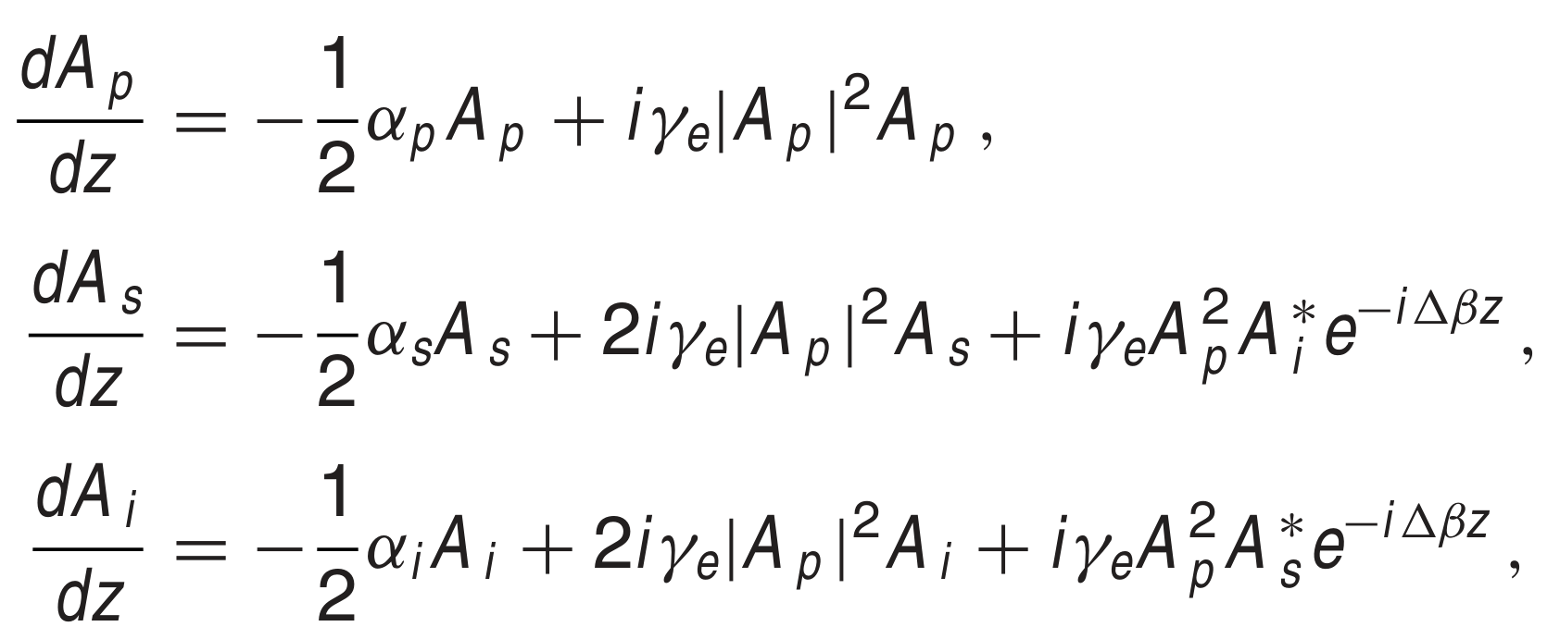
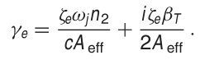
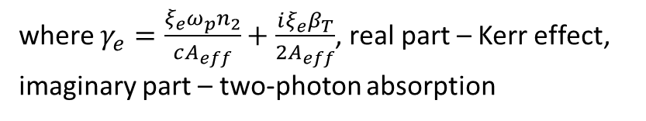
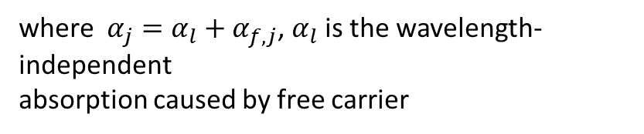
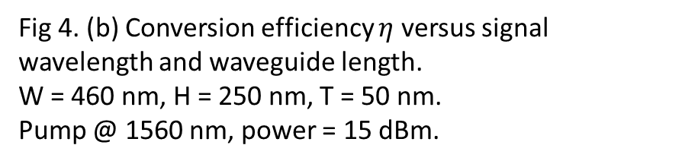
Simulation Process & Results
Using [4]:
where $α_{j}=α_{l}+α_{f,j}$, $α_{l}$ is the wavelength-independent
absorption caused by free carrier
Fig 4. (b) Conversion efficiency $η$ versus signal wavelength and waveguide length.
W = 460 nm, H = 250 nm, T = 50 nm.
Pump @ 1560 nm, power = 15 dBm.
where $γ_{e}=\frac{ξ_{e}ω_{p}n_{2}}{cA_{eff}}+\frac{iξ_{e}β_{T}}{2A_{eff}}$, real part – Kerr effect, imaginary part – two-photon absorption
[4] Guo, Kai, et al. "Full-vectorial propagation model and modified effective mode area of four-wave mixing in straight waveguides." Optics Letters 42.18 (2017): 3670-3673.

Slide 17
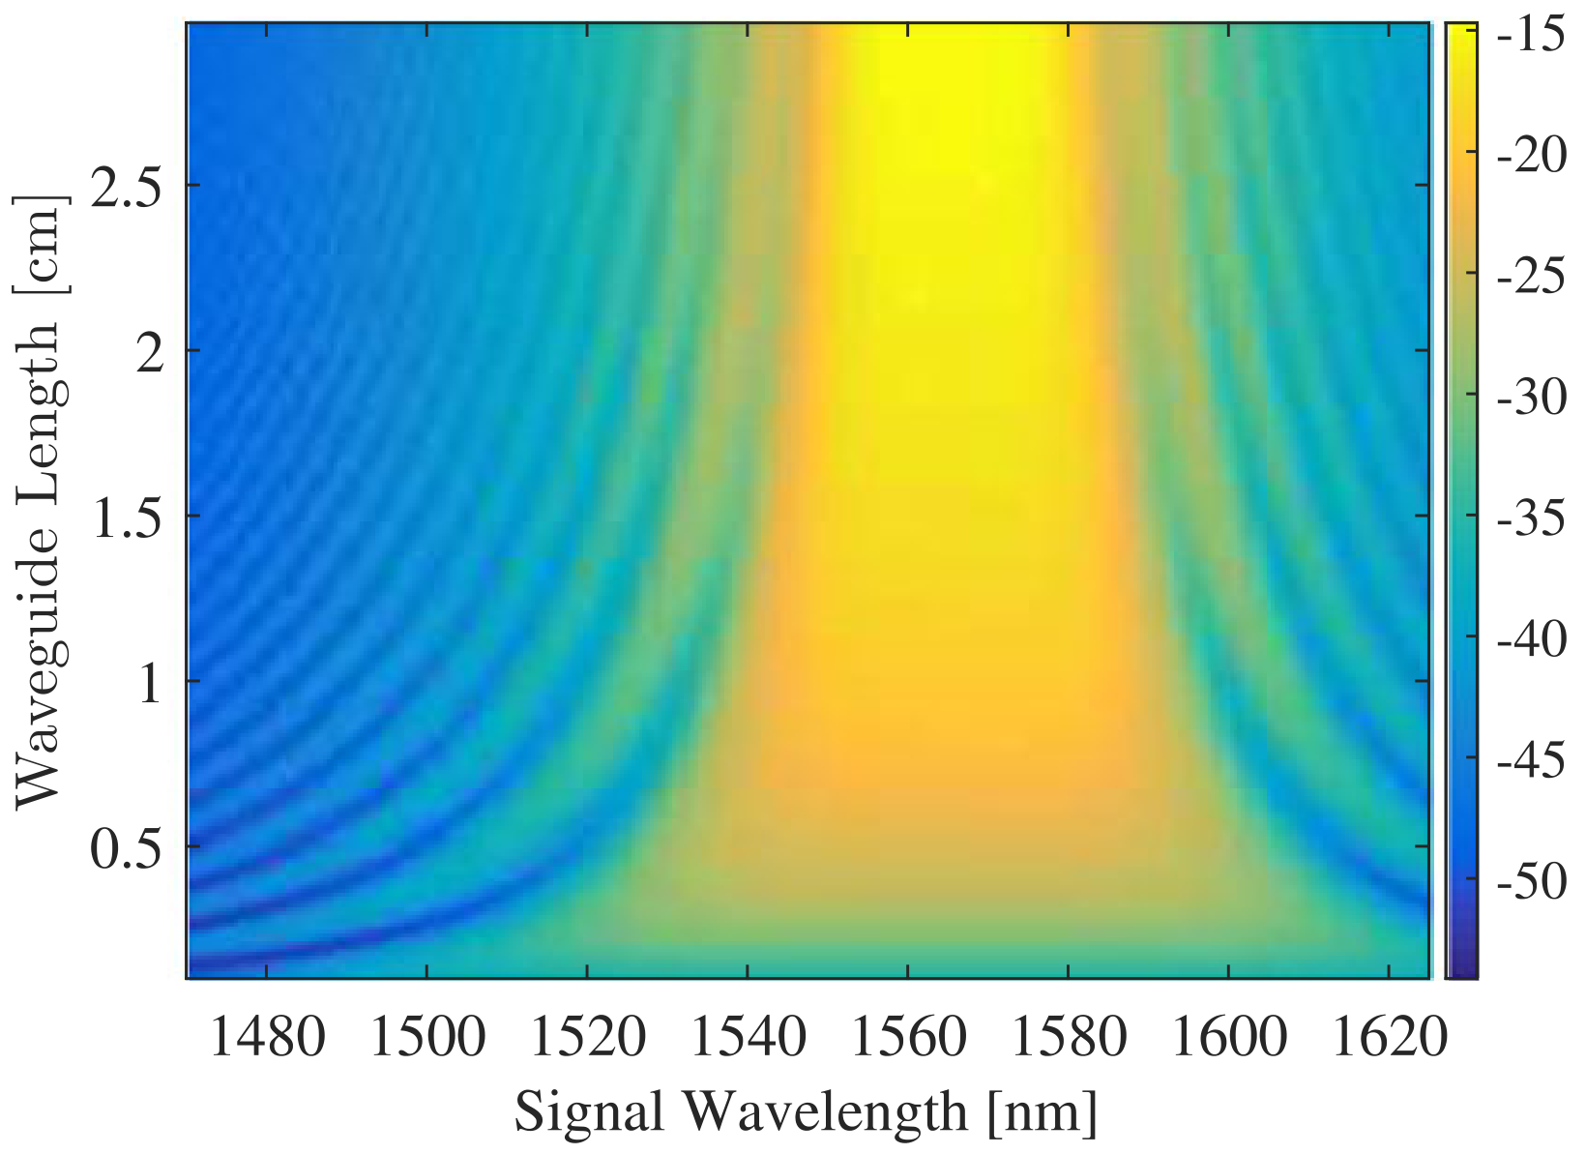
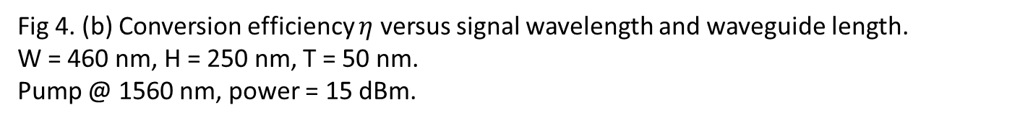
Simulation Process & Results
Original figures
Fig 4. (b) Conversion efficiency $η$ versus signal wavelength and waveguide length.
W = 460 nm, H = 250 nm, T = 50 nm.
Pump @ 1560 nm, power = 15 dBm.

Slide 18
Reference
[1] Guo, Kai, et al. "Experimentally validated dispersion tailoring in a silicon strip waveguide with alumina thin-film coating." Ieee Photonics Journal 10.1 (2018): 1-8.
[2] Fallahkhair, Arman B., Kai S. Li, and Thomas E. Murphy. "Vector finite difference modesolver for anisotropic dielectric waveguides." Journal of Lightwave Technology 26.11 (2008): 1423-1431.
[3] Boidin, Rémi, et al. "Pulsed laser deposited alumina thin films." Ceramics International 42.1 (2016): 1177-1182.
[4] Guo, Kai, et al. "Full-vectorial propagation model and modified effective mode area of four-wave mixing in straight waveguides." Optics Letters 42.18 (2017): 3670-3673.

